Slide 1
Applied Statistic & Queuing Theory
Course Code:407
Course Credit: 3.00
Lec Sahrima Jannat Oishwee
Lec Raiyan Rahman

Slide 2
BOOKS
Introduction to Probability Models (11th Edition) By Sheldon M. Ross
Link: http://mitran-lab.amath.unc.edu/courses/MATH768/biblio/introduction-to-prob-models-11th-edition.PDF

Slide 3
Chap 01: Introduction to Probability Theory
Sample Space: The set of all possible outcomes is known of an experiment. This set of all possible outcomes of an experiment is known as the sample space of the experiment and is denoted by S.
Example:
If the experiment consists of the flipping of a coin,
then S = {H, T }
where H means that the outcome of the toss is a head and T that it is a tail
If the experiment consists of rolling a die,
then the sample space is S = {1, 2, 3, 4, 5, 6}
where the outcome i means that i appeared on the die, i = 1, 2, 3, 4, 5, 6.

Slide 4
Examples
If the experiments consists of flipping two coins, then the sample space consists of the following four points:
S = {(H, H), (H, T ), (T, H), (T, T )}
The outcome will be (H, H) if both coins come up heads; it will be (H, T ) if the first coin comes up heads and the second comes up tails; it will be (T, H) if the first comes up tails and the second heads; and it will be (T, T ) if both coins come up tails.

Slide 5
Example
If the experiment consists of rolling two dice, then the sample space consists of the following 36 points:
S ={(1, 1), (1, 2), (1, 3), (1, 4), (1, 5), (1, 6) (2, 1), (2, 2), (2, 3), (2, 4), (2, 5), (2, 6) (3, 1), (3, 2), (3, 3), (3, 4), (3, 5), (3, 6) (4, 1), (4, 2), (4, 3), (4, 4), (4, 5), (4, 6) (5, 1), (5, 2), (5, 3), (5, 4), (5, 5), (5, 6) (6, 1), (6, 2), (6, 3), (6, 4), (6, 5), (6, 6)}
where the outcome (i, j) is said to occur if i appears on the first die and j on the second die.

Slide 6
Examples
If the experiment consists of measuring the lifetime of a car, then the sample space consists of all nonnegative real numbers.
That is, S = [0,∞)

Slide 7
Notation
The set (a, b) is defined to consist of all points x such that a < x < b.
The set [a, b] is defined to consist of all points x such that a <= x<= b.
The sets (a, b] and [a, b) are defined, respectively, to consist of all points x such that a < x <=b and all points x such that a <=x < b.

Slide 8
Event
Any subset E of the sample space S is known as an event.
Example:
In example (1), if E = {H}, then E is the event that a head appears on the flip of the coin.
Similarly, if E = {T }, then E would be the event that a tail appears.
In Example (2), if E = {1}, then E is the event that one appears on the roll of the die.
If E = {2, 4, 6}, then E would be the event that an even number appears on the roll.

Slide 9
Examples
In Example (3), if E = {(H, H), (H, T )}, then E is the event that a head appears on the first coin.
In Example (4), if E = {(1, 6), (2, 5), (3, 4), (4, 3), (5, 2), (6, 1)}, then E is the event that the sum of the dice equals seven.
In Example (5), if E = (2, 6), then E is the event that the car lasts between two and six years.

Slide 10
Union
For any two events E and F of a sample space S we define the new event E ∪ F to consist of all outcomes that are either in E or in F or in both E and F.
That is, the event E ∪ F will occur if either E or F occurs.
Example:
In (1) if E = {H} and F = {T }, then E ∪ F = {H, T } That is, E ∪ F would be the whole sample space S.
In (2) if E = {1, 3, 5} and F = {1, 2, 3}, then E ∪ F = {1, 2, 3, 5} and thus E ∪ F would occur if the outcome of the die is 1 or 2 or 3 or 5.
The event E ∪ F is often referred to as the union of the event E and the event F.

Slide 11
Intersection
For any two events E and F, we may also define the new event EF, sometimes written E ∩ F, and referred to as the intersection of E and F, as follows.
EF consists of all outcomes which are both in E and in F. That is, the event EF will occur only if both E and F occur.
For example, in (2) if E = {1, 3, 5} and F = {1, 2, 3}, then EF = {1, 3}
Thus EF would occur if the outcome of the die is either 1 or 3

Slide 12
Mutually Exclusive
If E = {H} and F = {T }, then the event EF would not consist of any outcomes and hence could not occur.
To give such an event a name, we shall refer to it as the null event and denote it by Ø. (That is, Ø refers to the event consisting of no outcomes.)
If EF = Ø, then E and F are said to be mutually exclusive.

Slide 13
Complement
For any event E we define the new event Ec, referred to as the complement of E, to consist of all outcomes in the sample space S that are not in E.
Ec= S-E
S= {(1,6),(2,5),(3,4),(4,3),(5,2),(6,1)}
E1= {(2,5),(3,4),(4,3),(5,2)}
E1c= {(1,6),(6,1)}
S=E
Ec= Ø
Sc= Ø
E = {(1, 6), (2, 5), (3, 4), (4, 3), (5, 2), (6, 1)}, then Ec will occur if the sum of the dice does not equal seven. Also note that since the experiment must result in some outcome, it follows that Sc = Ø.

Slide 14

Probabilities Defined on Events
Consider an experiment whose sample space is S. For each event E of the sample space S, we assume that a number P(E) is defined and satisfies the following three conditions:
(i) 0<= P(E) <=1.
(ii) P(S) = 1.
(iii) For any sequence of events E1, E2,... that are mutually exclusive, that is, events for which En Em = Ø then
We refer to P(E) as the probability of the event E.
Right, P(e1)+p(e2)+p(e3)
Left, P(e1 U e2 U e3)
P(EUC)=P(E)+p(C)-P(EC); P(EUC)=P(E)+P(C)

Slide 15
Examples
Example 1.1
In the coin tossing example, if we assume that a head is equally likely to appear as a tail, then we would have
P({H}) = P({T }) = ½
On the other hand, if we had a biased coin and felt that a head was twice as likely to appear as a tail, then we would have
P({H}) = 2/3 , P({T }) = 1/3
P(H)+P(T)=2/3+1/3=1

Slide 16
Theorem
E and Ec are always mutually exclusive and since
E ∪ Ec = S
1 = P(S)
= P(E ∪ Ec )
= P(E) + P(Ec )
or P(Ec ) = 1 − P(E)…………………………..(1.1)
In words, Equation (1.1) states that the probability that an event does not occur is one minus the probability that it does occur.

Slide 17
Inclusion-exclusion identity Theorem
Now we will consider two different events where E and F are that events :
P(E) + P(F) = P(E ∪ F) + P(EF)
Or P(E ∪ F) = P(E) + P(F) − P(EF) …………….(1.2)
when E and F are mutually exclusive (that is, when EF = Ø),
then Equation (1.2) states that
P(E ∪ F) = P(E) + P(F) − P(Ø)
= P(E) + P(F)

Slide 18
Example
Suppose that we toss two coins, and suppose that we assume that each of the four outcomes in the sample space S = {(H, H), (H, T ), (T, H), (T, T )} is equally likely and hence has probability 1/4 .
Let E = {(H, H), (H, T )} and F = {(H, H), (T, H)}
That is, E is the event that the first coin falls heads, and F is the event that the second coin falls heads.
P(E)=1/4 +1/4 =1/2
P(F)=1/2
P(E ∪ F) = P(E) + P(F) − P(EF)
= 1/2 + 1/2 − P({H, H})
= 1 − 1/4 = ¾
This probability could, of course, have been computed directly since P(E ∪ F) = P({H, H), (H, T ), (T, H)}) = 3/4

Slide 19
Theorem Cont.
If there are 3 events, E ,F and G
So, P(E ∪ F ∪ G) = P((E ∪ F) ∪ G)
From Equation (1.2),
P(E ∪ F) + P(G) − P((E ∪ F)G)
(E ∪ F)G and EG∪FG are equivalent.
P(E ∪ F ∪ G) =P(E ∪ F) + P(G) − P((E ∪ F)G)
=P (E U F)+ P(G) – P (EG∪FG )
= P(E) + P(F) − P(EF) + P(G) − P(EG ∪ FG)
= P(E)+P(F)+P(G)-P(EF)- [P(EG)+P(FG)-P(EGPG)]
= P(E) + P(F) + P(G) − P(EF) − P(EG) − P(FG) + P(EGFG)
= P(E) + P(F) + P(G) − P(EF) − P(EG) − P(FG) + P(EFG)….(1.3)

Slide 20
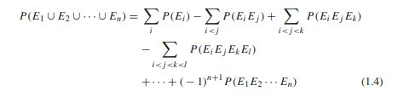
Theorem Cont.
In fact, it can be shown by induction that, for any n events E1, E2, E3,..., En,

Slide 21
Theorem Cont.
This theorem, states that the probability of the union of n events equals the sum of the probabilities of these events taken one at a time minus the sum of the probabilities of these events taken two at a time plus the sum of the probabilities of these events taken three at a time, and so on

Slide 22
Conditional Probabilities
There are two events E and F :
P(E|F) = P(EF) /P(F)
When P(F) > 0 and hence P(E|F) is only defined when P(F) > 0

Slide 23
Example
Example 1.4:Suppose cards numbered one through ten are placed in a hat, mixed up, and then one of the cards is drawn. If we are told that the number on the drawn card is at least five, then what is the conditional probability that it is ten?
Solution: P(E|F) = P(EF) / P(F)
P(F)= card is at least 5 = 6/10
E=10
P(E)=1/10
F=5,6,7,8,9,10
EF=1
P(EF)=1/10
Hence, P(E|F) = (1 /10)/ (6 /10) = 1/6

Slide 24
Example
Example 1.5: A family has two children. What is the conditional probability that both are boys given that at least one of them is a boy?
Solution:
Assume that the sample space S is given by S = {(b, b), (b, g), (g, b), (g, g)}, and all outcomes are equally likely
A= {(b, b), (b, g), (g, b)}
A= at least one of the children will be boy
p(A)=3/4
B= {(b,b)}
AB={(b,b)}
P(BA)= 1/4
P(B|A) = P(B A) / P(A) =P({(b, b)}) / P({(b, b), (b, g), (g, b)})
= (¼) / (3/4)
= 1/3

Slide 25
Example
Example 1.6 Bev can either take a course in computers or in chemistry. If Bev takes the computer course, then she will receive an A grade with probability 1/ 2 ; if she takes the chemistry course then she will receive an A grade with probability 1/ 3 . Bev decides to base her decision on the flip of a fair coin. What is the probability that Bev will get an A in chemistry?
Solution:
P(A|Co)=1/2
P(A|C)= 1/3
P(H)=P(Co)=1/2
P(T)=P(C)=1/2
P(A|C)=P(AC)/P(C)
P(AC) = P(C)P(A|C) = (1 /2) (1/ 3) = 1/6

Slide 26
Example
Example 1.7 Suppose an urn contains seven black balls and five white balls. We draw two balls from the urn without replacement. Assuming that each ball in the urn is equally likely to be drawn, what is the probability that both drawn balls are black?
Solution:
F= 1st ball is black
E=2nd ball in black
Total number of black balls= 7
Total number of balls =12
P(F)=7/12
P(E|F)=6/11
As P(F) is clearly 7/12 ,P(E|F) = 6/11
our desired probability is P(EF) = P(F) P(E|F) = (7/12) (6/11) = 42/132

Slide 27
Example
Suppose that each of three men at a party throws his hat into the center of the room. The hats are first mixed up and then each man randomly selects a hat. What is the probability that none of the three men selects his own hat?
Solution:
E1 E2 E3
P(E1)=1/3
P(E1E2)=P(E1)P(E2|E1)=(1/3) * (½)= 1/6
Let, E1E2= E
P(E1E2E3)=P(EE3)=P(E)P(E3|E)=(1/6) *1 =1/6
P(E1 U E2 U E3) = P(E1)+P(E2)+P(E3)-P(E1E2)-P(E2E3)-P(E1E3)+P(E1E2E3)= 1/3 + 1/3+ 1/3-(1/6+ 1/6+1/6)+1/6=1-(1/2)+1/6=2/3
P(E)+P(Ec) = 1
P(Ec)=1-P(E1UE2UE3)=1-2/3=1/3

Slide 28

Independent Events
Two events E and F are said to be independent
if P(EF) = P(E)P(F)
By Equation (1.5) this implies that E and F are independent
if P(E|F) = P(E) (which also implies that P(F|E) = P(F)).
If, for all i1,i2,...,in,
we say that the sequence of experiments consists of independent trials

Slide 29

Bayes’ Formula
Let E and F be events. We may express E as
E= E(F U Fc)= EF U EFc
Since EF and EFc are mutually exclusive,
we have that P(E) = P(EF) + P(EFc )
Conditional probability : P(E|F)= P(EF)/P(F)
or, P(EF)=P(E|F) P(F)
Similarly, P(EFc)=P(E|Fc) P(Fc)
So, P(E)= P(E|F)P(F) + P(E|Fc) P(Fc)
= P(E|F) P(F) + P(E|Fc) (1-P(F))

Slide 30
Example
Example 1.12 Consider two urns. The first contains two white and seven black balls, and the second contains five white and six black balls. We flip a fair coin and then draw a ball from the first urn or the second urn depending on whether the outcome was heads or tails. What is the conditional probability that the outcome of the toss was heads given that a white ball was selected?
Solution: 1st urn W=2, B=7
P(W|H)= 2/9
2nd urn W =5, B=6
P(W|T) = 5/11 so, P(W|Hc)=5/11
P(H|W) = P(HW)/P(W)
= P(W|H)P(H)/(P(W|H)P(H)+ P(W|Hc)P(Hc))
= (2/9 * ½)/( (2/9 * ½)+ (5/11* ½)) = 22/67

Slide 31
Example
In answering a question on a multiple-choice test a student either knows the answer or guesses. Let p be the probability that she knows the answer and 1− p the probability that she guesses. Assume that a student who guesses at the answer will be correct with probability 1/m, where m is the number of multiple-choice alternatives. What is the conditional probability that a student knew the answer to a question given that she answered it correctly?
P(K|C)=P(KC)/P(C)=(P(C|K)P(K))/(P(C|K)P(K)+P(C|Kc)P(Kc))
Given, P(K)=p , P(Kc)=1-p, P(C|Kc)=1/m
P(K|C)=P(C|K)*p / (P(C|K) p +1/m(1-p))= 1 * p / (1*P +1/m(1-p))
=mp/1+(m-1)p

Slide 32
Example
Example 1.14 A laboratory blood test is 95 percent effective in detecting a certain disease when it is, in fact, present. However, the test also yields a “false positive” result for 1 percent of the healthy persons tested. (That is, if a healthy person is tested, then, with probability 0.01, the test result will imply he has the disease.) If 0.5 percent of the population actually has the disease, what is the probability a person has the disease given that his test result is positive?
Solution: E= tested positive, D= Disease have
P(D|E)= P(DE)/P(E)=P(E|D)P(D)/(P(E|D)P(D)+P(E|Dc)P(Dc))
= (0.95) (0.005)/((0.95) (0.005) + (.01)(.995))
=95/294=0.323

Slide 33


Generalizing Equation
Suppose that F1, F2,..., Fn are mutually exclusive events such that
In other words, exactly one of the events F1, F2,..., Fn will occur. By writing:
and using the fact that the events EFi,i = 1,..., n, are mutually exclusive, we obtain that:

Slide 34

Generalizing Equation Cnt.
Now ,

Slide 35
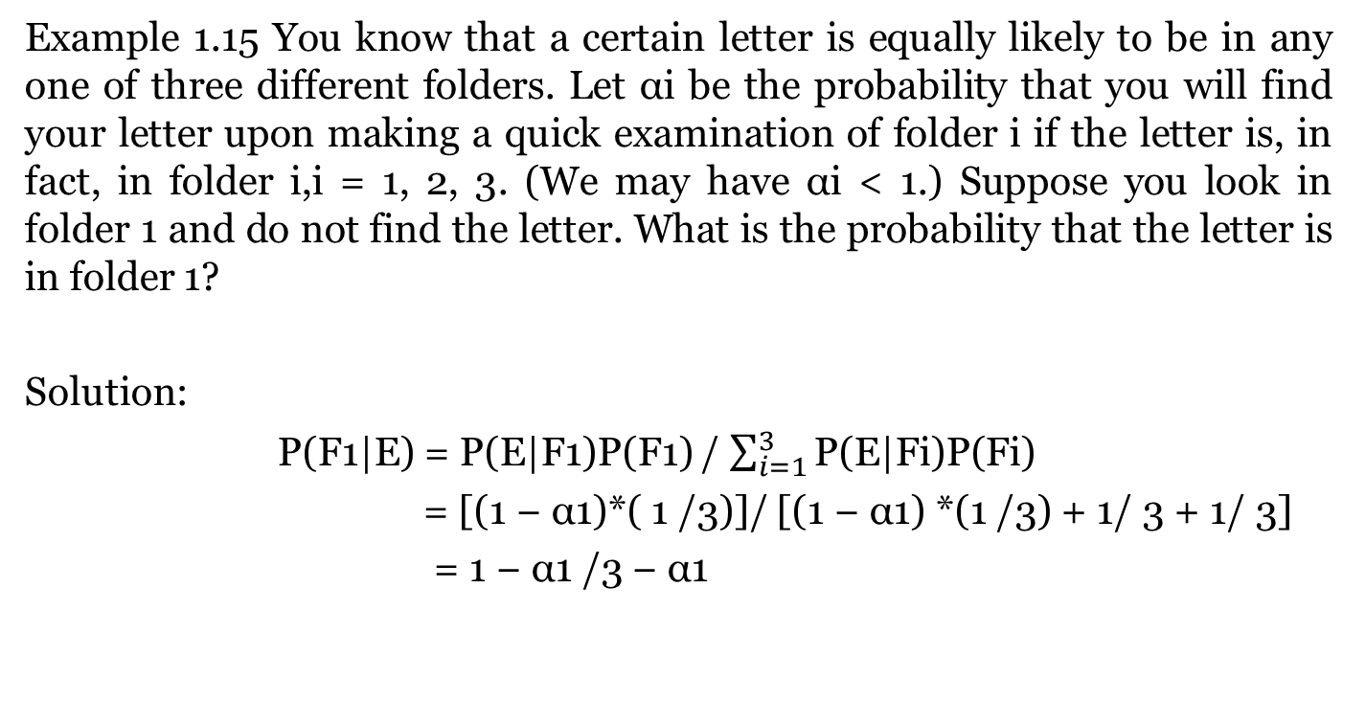
Example
Example 1.15 You know that a certain letter is equally likely to be in any one of three different folders. Let αi be the probability that you will find your letter upon making a quick examination of folder i if the letter is, in fact, in folder i,i = 1, 2, 3. (We may have αi < 1.) Suppose you look in folder 1 and do not find the letter. What is the probability that the letter is in folder 1?
Solution:
P(F1|E) = P(E|F1)P(F1) / $\sum_{i=1}^{3}{\text{P}\text{(}\text{E}\text{|}\text{Fi}\text{)}\text{P}\text{(}\text{Fi}\text{)}}$
= [(1 − α1)*( 1 /3)]/ [(1 − α1) *(1 /3) + 1/ 3 + 1/ 3]
= 1 − α1 /3 − α1

